Slide 1

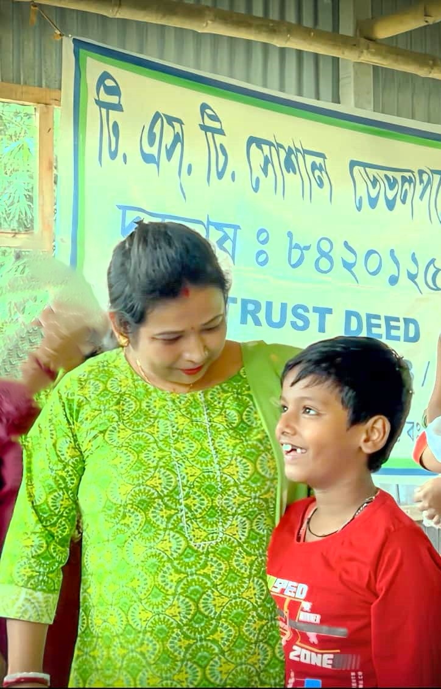
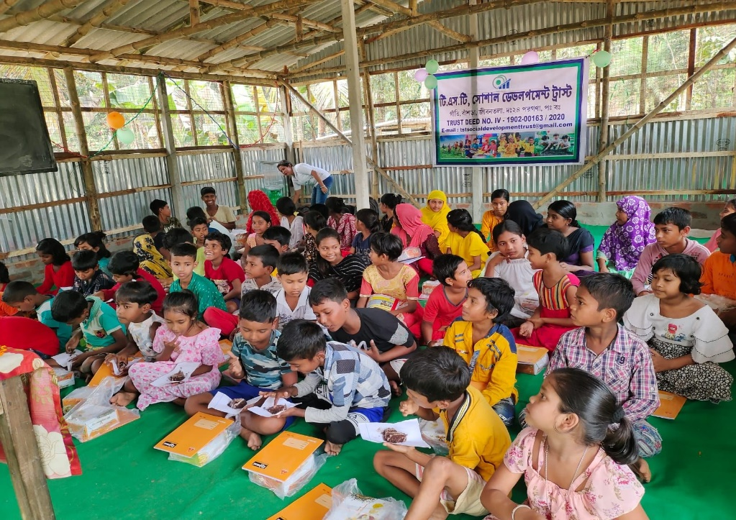
Master Project Report for TST Social Development Trust.
Project Name: Project Progotishila প্রগতিশীলা(The Progressive Path).
Organization: TST Social Development Trust (Jibantala, South 24 Parganas).
Registration: 80G/12A Validated.
Tagline: "Farming for Nutrition, Coaching for Champions."

Slide 2
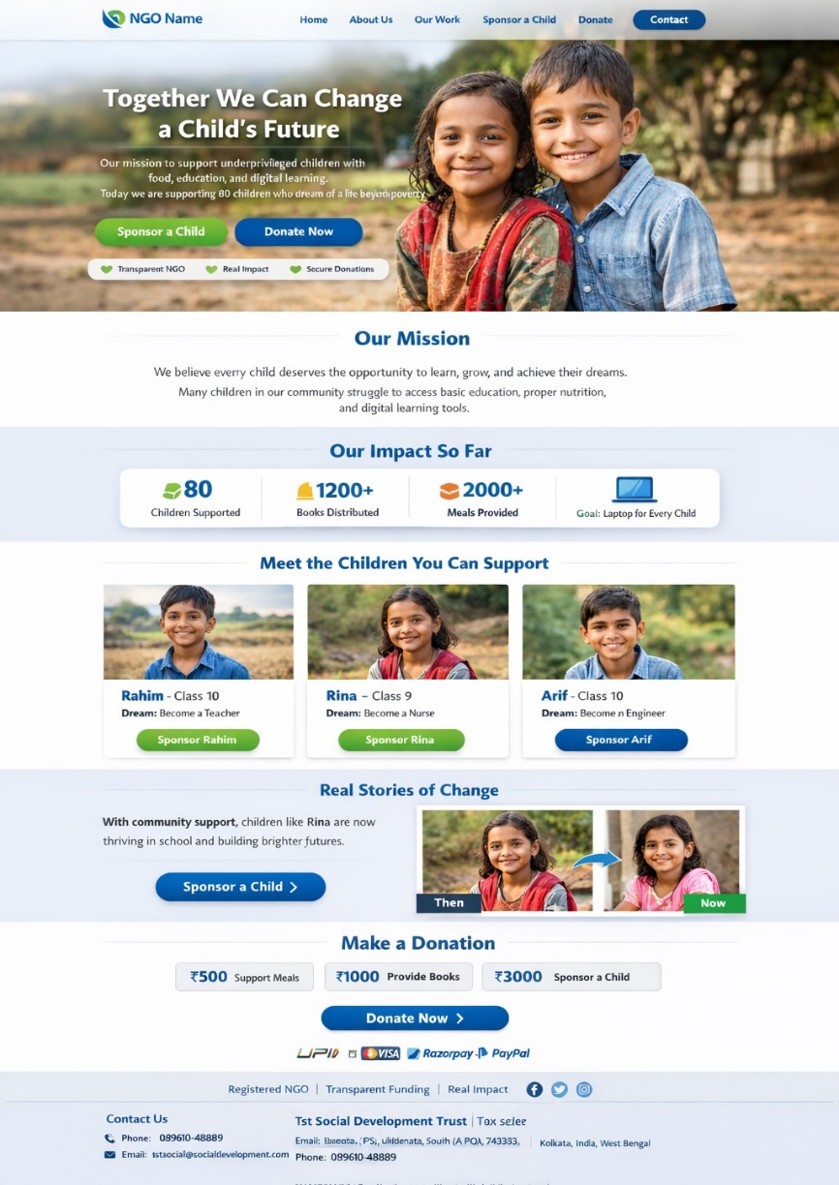
Website Design and Social media
Fundraising & Accessibility: A website with a dedicated "Donate Now" button makes contributing simple and convenient for a global pool of donors. In India, 29% of donors report being inspired to give specifically through social media.
Transparency & Credibility: Sharing real-time updates from the field (like a video of the banana harvest or pond maintenance) builds deep trust. Displaying "Impact Metrics"—such as the number of families supported by these ponds—provides verifiable evidence of your success.
Awareness & Advocacy: Social media allows you to bypass geographical barriers to reach media outlets and policymakers at little to no cost. Visual storytelling through impactful photos and short videos is particularly effective for humanizing your mission.
Community & Volunteer Growth: Platforms like Facebook and LinkedIn are essential for building a loyal network of supporters and recruiting skilled volunteers for your projects

Slide 3
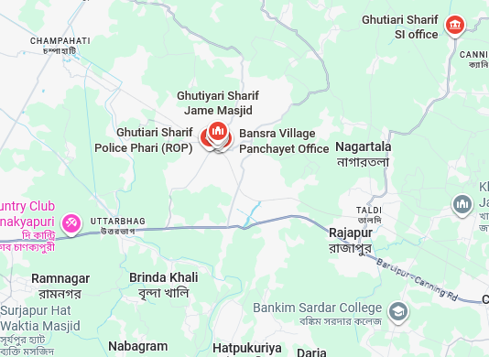
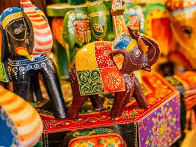

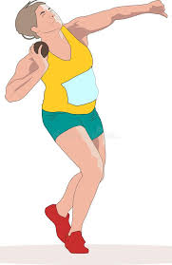
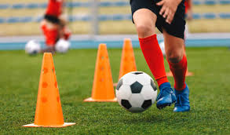
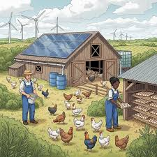
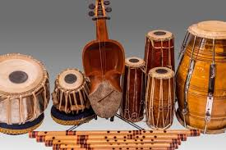

Executive Summary
Vision: Holistic development of 80 children through an integrated model of Education, Sports, Culture, and Sustainable Agriculture.
Location: Ganti, Banshra (P.S. Jibantala).
Current Asset: 2 Bighas (approx. 28,800 sq. ft.) of land with two ponds.

Slide 4

The Current Reality (Status Quo)
Infrastructure: 20x15 ft bamboo/tin shed (serving 80 children).
Human Resource: 2 dedicated volunteer tutors.
Achievement: Despite zero facilities, 5+ children have played at the District level; many excel in Painting & Recitation.

Slide 5


Critical Gap Analysis
Security: No boundary fencing (Risk to land and upcoming assets).
Education: No library or digital tools for modern learning.
Nutrition: Stunting and low stamina among students due to poverty.
Livelihood: Families are landless daily-wage earners.

Slide 6
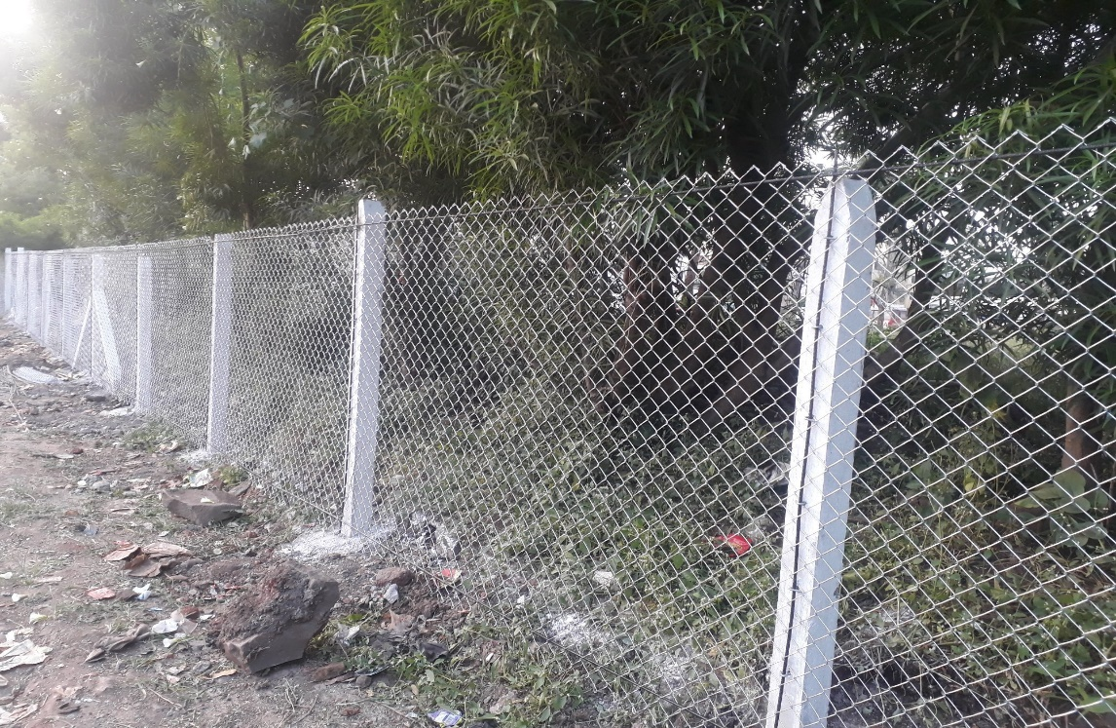
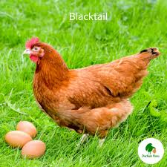
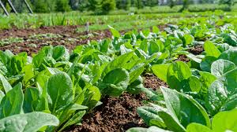
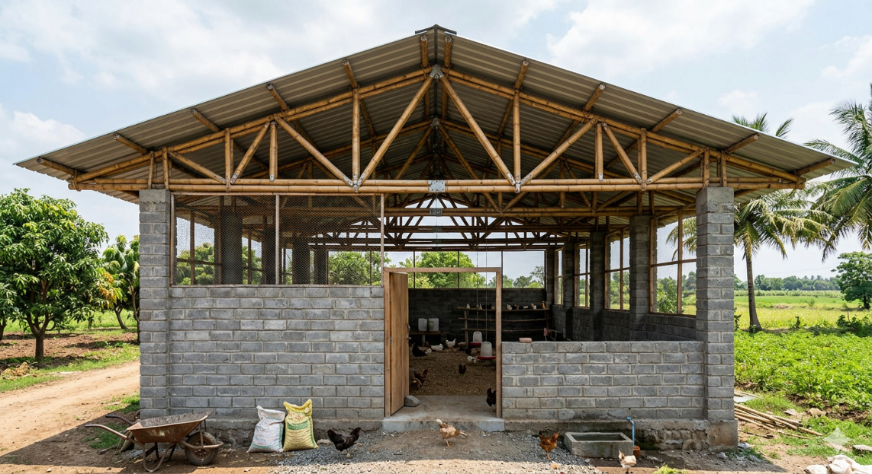
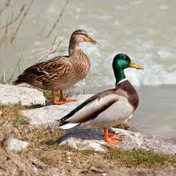
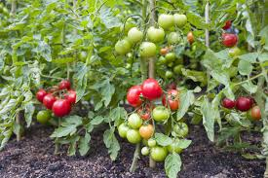
The "Quad-Impact" Strategy
Security: Full GI Fencing.
Infrastructure: 1,200 sq. ft. Multi-purpose Centre.
Nutrition: Integrated Livestock (Duck/Fish/Poultry).
Talent: Professional Sports & Cultural Coaching.

Slide 7

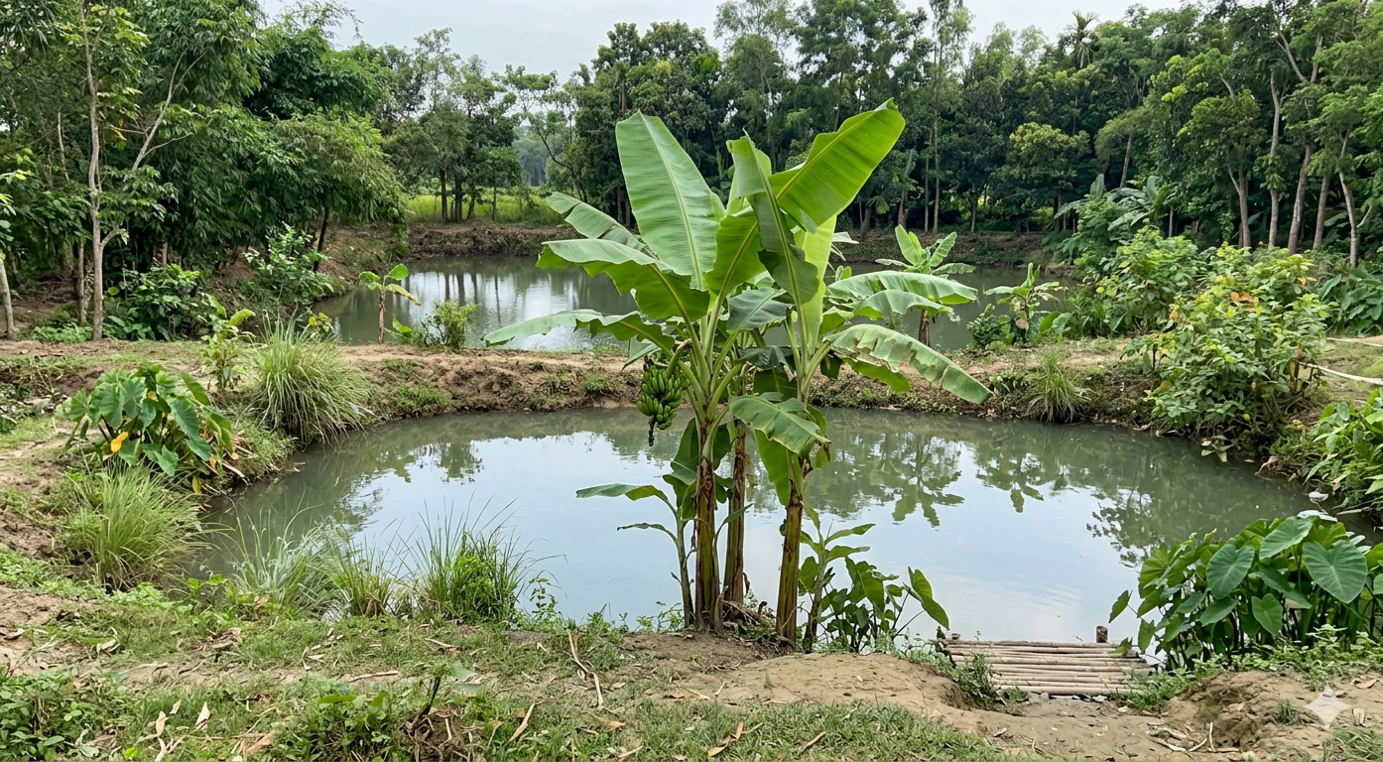
Phase 1 – Security & Campus Perimeter
Goal: Secure the 2-bigha perimeter to prevent encroachment and protect livestock.
Spec: Concrete Pillars + GI Chain Link Mesh.
Estimated Cost: ₹ 80,000.

Slide 8

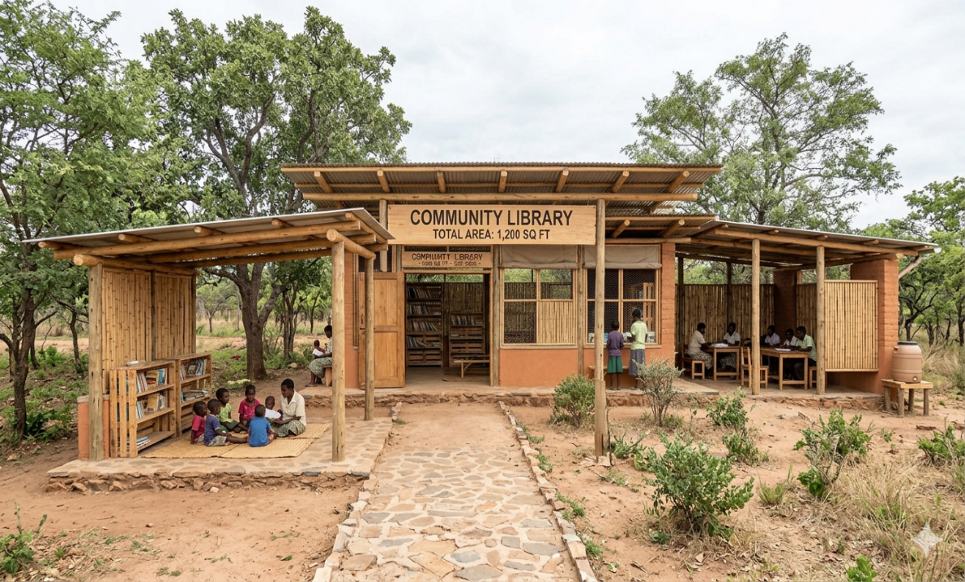
Phase 2 – The "Vidya-Kala" Bhawan
Design: 1,200 sq. ft. semi-permanent hybrid structure (Fly-ash bricks + Bamboo truss).
Layout: 3 Modular Classrooms, 1 Art/Recitation Corner, 1 Library Room.
Costing: ₹15,00,000 (Rural standard). Donation Request Letter

Slide 9



The Knowledge Resource Center (Library)
Focus: Academic books, storybooks, and competitive exam guides.
Initial Stock: 500 books + 2 Learning Tablets.
Furniture: Durable metal racks and reading desks.
Budget: ₹1,20,000.
Donation Request

Slide 10
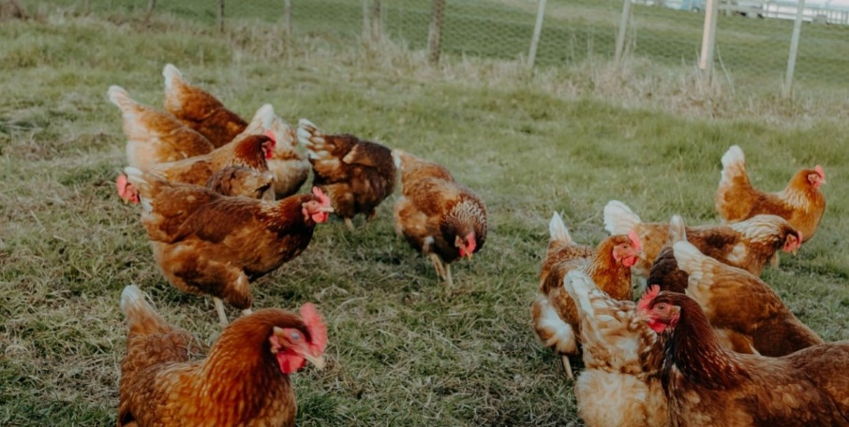
Integrated Livestock Model (Duckery & Poultry)
Model: 100 Ducks (Khaki Campbell) + 50 Free-range Chickens.
Integration: Sheds built over the two ponds to recycle waste as fish feed.
Outcome: 80+ eggs per day for student nutrition.

Slide 11
Aquaculture (Blue Revolution)
Current Asset: 2 Small Ponds.
Enhancement: Scientific stocking of Rohu, Katla, jiol mach and Tilapia
Cycle: Annual harvest providing protein and revenue.
Budget (Seed & Feed): ₹1,00,000.

Slide 12
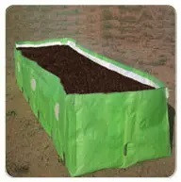
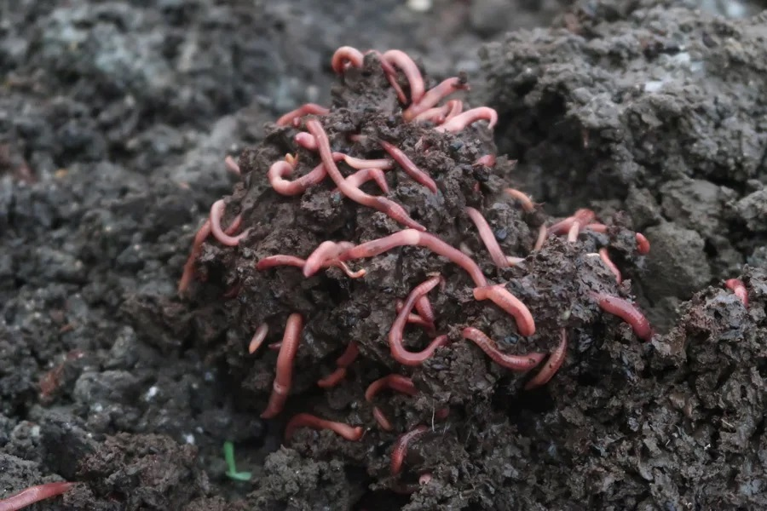
The Organic Kitchen Garden
Concept: Utilizing 0.5 Bigha for seasonal vegetables (Spinach, Gourds, Tomatoes).
Method: Vermicomposting using pond waste.
Benefit: Zero-cost organic vegetables for daily student snacks.

Slide 13
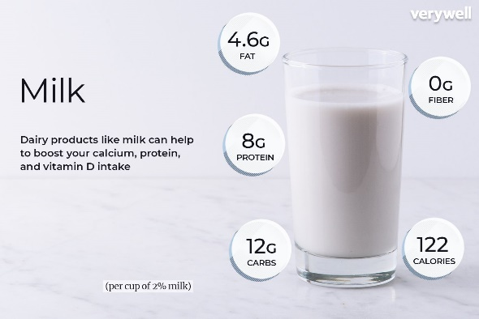
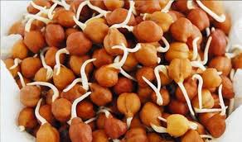

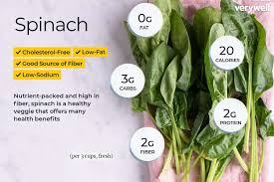
High-Protein Nutrition Program
The "Champion’s Plate":
  Daily: 1 Boiled Egg + Sprouted Chana.
  Weekly: Vegetable Medley from the garden.
  Monthly: Fresh fish protein from the ponds.
Target: Increasing bone density and stamina for athletes.

Slide 14

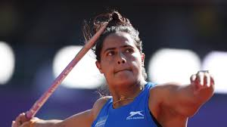
Sports Excellence Module
Current Success: 4 District-level players.
Requirement: Leveling 0.5 Bigha for Athletics/Football practice + basic kits.
Coaching: Hiring weekend specialist coaches using Trust revenue.
Budget: ₹80,000 (Equipment's/Ground prep).

Slide 15
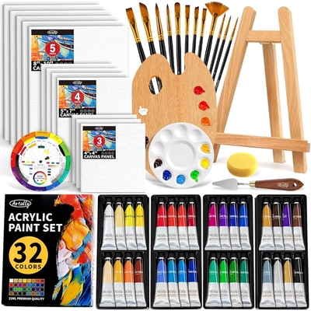
Cultural & Arts Wing
Talent: Painting, Recitation, and Folk Arts.
Facility: Dedicated wall space for mural painting and a sound-cushioned recitation corner.
Tools: Professional paint kits, easels, and a portable sound system.
Budget: ₹50,000.

Slide 16
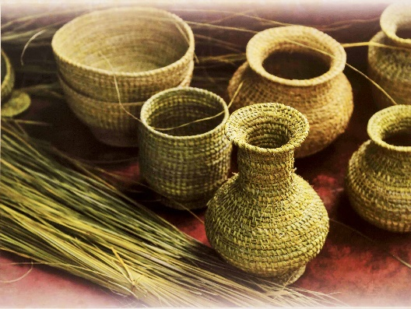

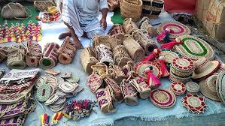
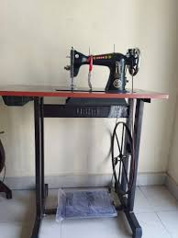
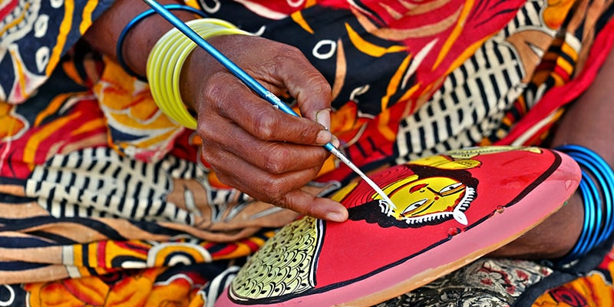
Parent Empowerment (Socio-Economic Upliftment)
SHG Model: 10 Mothers' Self-Help Groups managing the livestock.
Livelihood: Profit sharing from egg/fish sales to boost household income.
Training: Monthly workshops on financial literacy and organic farming.

Slide 17

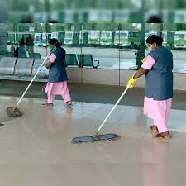
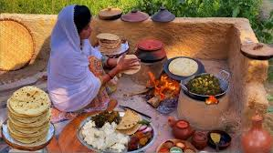
Socio-Economic Impact Metrics
Household Income: Target increase of 40% for the 80 families.
Employment: Direct work for 15+ parents within the Trust’s campus.
Social Linkage: 100% families linked to Govt schemes via the library’s Digital Desk.

Slide 18
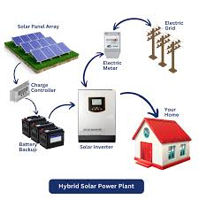

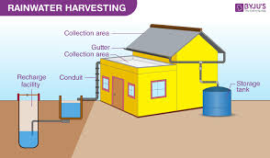
Environmental Sustainability
Solar Power: 3kW ON/Off-grid system for night study and practice.
Water: Rainwater harvesting for the kitchen garden.
Waste: Closed-loop organic cycle between livestock and vermicomposting.

Slide 19
Financial Summary (CapEx Year 1)
Fencing & Infrastructure: ₹16.80L (Fencing ₹ 80,000+LIBRARY BUILDING+20X18 STUDY ROOM+STORE ROOM 10X10+KITCHEN 8X10)
Website Design and social media outrage ₹ 1,50,000
Livestock & Agriculture: ₹3.00L
Library, Sports & Culture: ₹2.50L
Total Project Outlay: ₹23.80 Lakhs.

Slide 20
Implementation Roadmap (12 Months)
Q1: Security Fencing + SHG Formation.(Jan to Mar 26)
Q2: Livestock Start-up + Pond Seeding. (Apr to Jun 26)
Q3: Building Construction + Library Setup.(Jul to Sept 26)
Q4: Launch of High-Protein Nutrition + Coaching Academy.(Oct to dec 26)

Slide 21
Conclusion & Call to Action
The Ask: Partner with TST Social Development Trust to build a self-sufficient village model.
Contact: Ganti, Banshra, South 24 Parganas, 743363.
Closing: "Transforming Jibantala’s Talent into Bengal’s Pride."

